Slide 1

Naming, Functions, & More Data Types
LECTURE 04
Using functions to make life easier,
Intro to string data types
Spark 10, Spring 2024
Developed by students and faculty at UC Berkeley and Tuskegee University
data6.org/su23/syllabus/#acknowledgements-

Slide 2
Today’s Roadmap
Assigning Names
Call Expressions, Functions
The str Data Type
Conversion and Casting
Lecture 04, Spark 10 Spring 2024

Slide 3
Assigning Names
➤
1. Assigning Names
2. Call Expressions
3. The str Data Type
4. Conversion and Casting

Slide 4
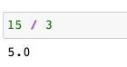
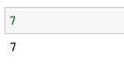
“Storing” Values by Assigning Names
So far we’ve seen how Python evaluates expressions into values:
expression
value

Slide 5
“Storing” Values by Assigning Names
So far we’ve seen how Python evaluates expressions into values:
expression
value
A critical aspect of a programming language is its ability to “store” and “retrieve” values.
In Python, storage and retrieval of values is done by binding names to values with the assignment operator (=).
x
3
This is called an assignment statement.
x = 3

Slide 6
Assignment Statements
assignment
x = 3
name
value
*no animals were harmed in the making of these vinyl suitcases
Notes:
Google: python suitcase for images
Python paradigm uses names and values
You may hear the word variable used in other computing contexts, but we have a specific definition of variable in this class that we’ll come to in a few lectures

Slide 7


Assignment Statements
Like a suitcase tag, the name x is bound to the value 3.
assignment
x
x = 3
name
value
3
x
3
analogy
*no animals were harmed in the making of these vinyl suitcases
Notes:
Google: python suitcase for images
Python paradigm uses names and values
You may hear the word variable used in other computing contexts, but we have a specific definition of variable in this class that we’ll come to in a few lectures

Slide 8

Assignment Statements
Like a suitcase tag, the name x is bound to the value 3.
assignment
x = 3
x
name
value
x = 1 + 2 * 3 - 4 // 5
7
Python first evaluates the right hand expression, then binds the name x to the resulting value.
*no animals were harmed in the making of these vinyl suitcases
Notes:
Google: python suitcase for images
Python paradigm uses names and values
You may hear the word variable used in other computing contexts, but we have a specific definition of variable in this class that we’ll come to in a few lectures

Slide 9
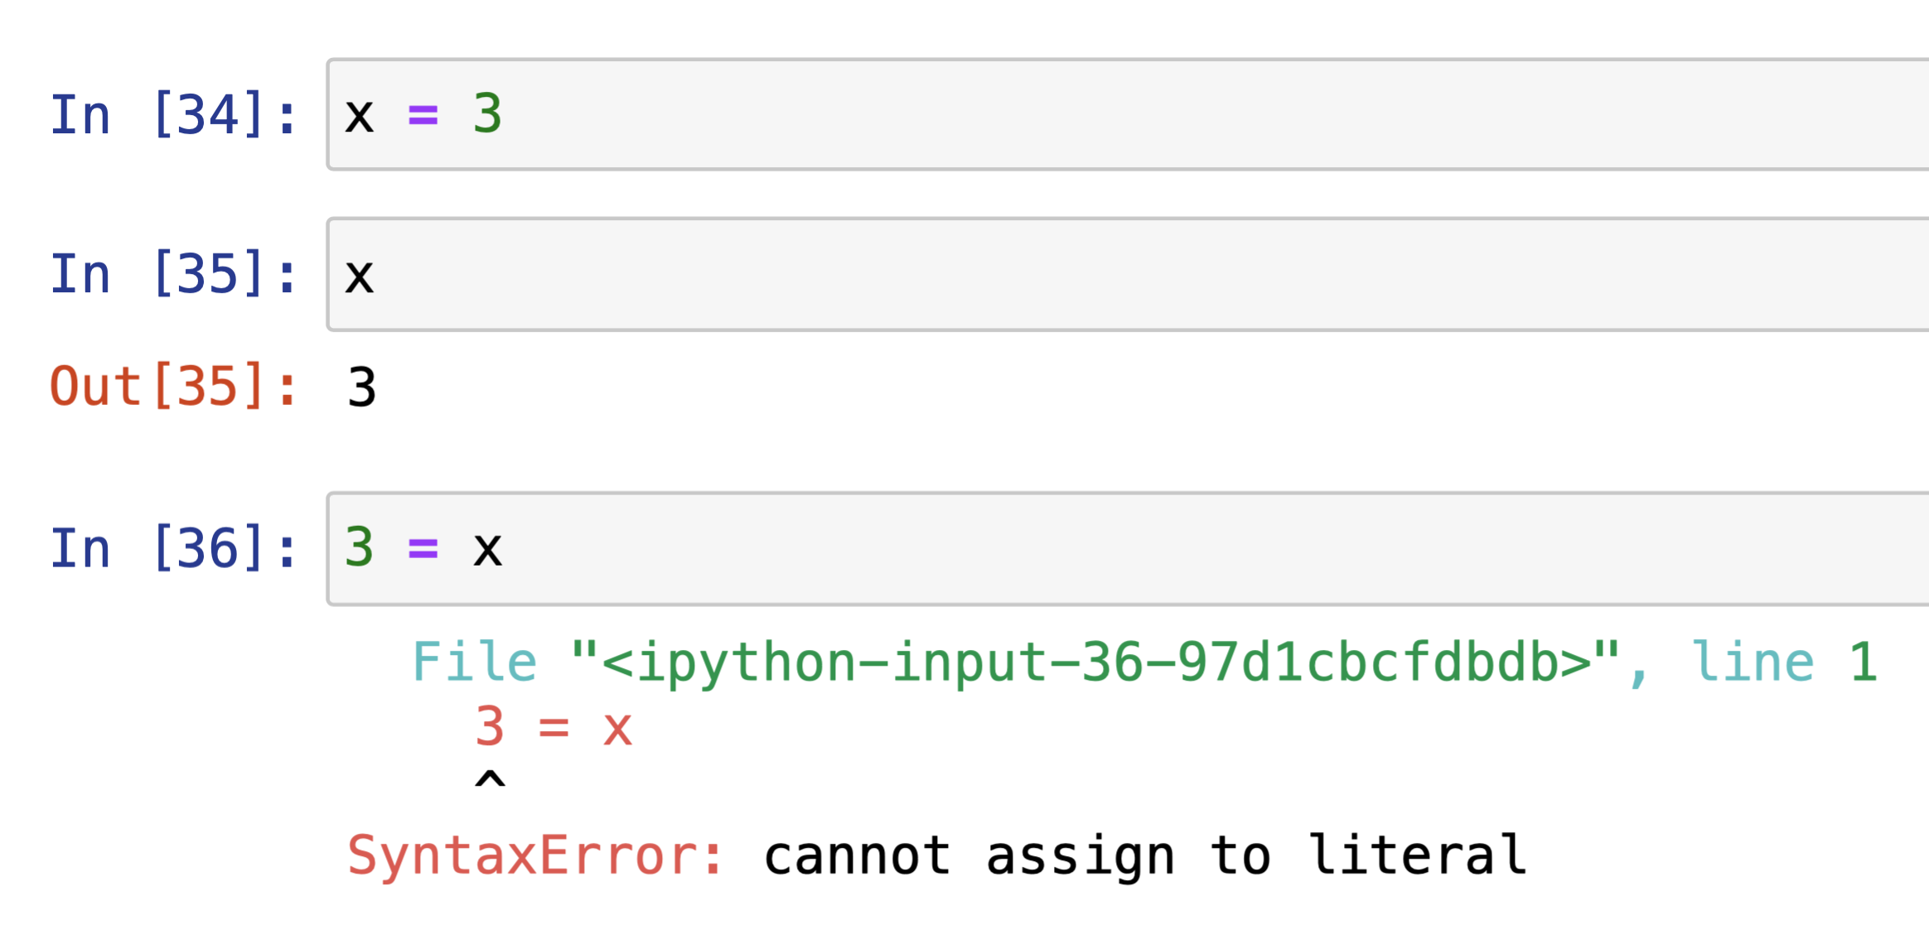
Assignment Statements
Like a suitcase tag, the name x is bound to the value 3.
assignment
x = 3
Assignment statements do not return anything. They just bind a name to a value.
name
value
x = 1 + 2 * 3 - 4 // 5
Python first evaluates the right hand expression, then binds the name x to the resulting value.
*no animals were harmed in the making of these vinyl suitcases
Notes:
Google: python suitcase for images
Python paradigm uses names and values
You may hear the word variable used in other computing contexts, but we have a specific definition of variable in this class that we’ll come to in a few lectures

Slide 10

Why the Suitcase Analogy?
Suitcases are containers, which contain things (values) or more suitcases
Just like a luggage tag, the names of values can change (I swap out the luggage tag)
The stuff in the suitcase is still there, we just have a new tag
I can use multiple names to refer to the same value (you can have multiple luggage tags on your suitcase)

Slide 11
Assignment Statements Are Not Mathematical Equations!!
This statement errors because Python tries to bind the name 3 to the value x.

Slide 12
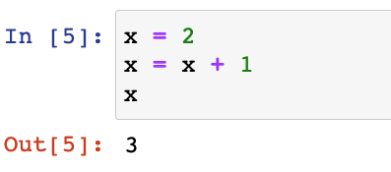

Assignment Statements Are Not Mathematical Equations!!
This statement errors because Python tries to bind the name 3 to the value x.
A name can only be bound to a single value at one time.
This code does not error.
x
2
1) Assignment statement

Slide 13

Assignment Statements Are Not Mathematical Equations!!
This statement errors because Python tries to bind the name 3 to the value x.
A name can only be bound to a single value at one time.
This code does not error.
x
2
3
2) Right hand side (RHS) evaluated…

Slide 14
Assignment Statements Are Not Mathematical Equations!!
This statement errors because Python tries to bind the name 3 to the value x.
A name can only be bound to a single value at one time.
This code does not error.
x
2
3
2b) …then assigned to name on LHS

Slide 15
Assignment Statements Are Not Mathematical Equations!!
This statement errors because Python tries to bind the name 3 to the value x.
A name can only be bound to a single value at one time.
This code does not error.
x
2
3
3) Evaluating a name returns its bound value.

Slide 16
Naming
There are some rules on names.
They can contain uppercase and lowercase letters, the digits 0-9, and underscores.
Allowed: how_are_you, my_AGE_is_22, NETFLIXPASSWORD
Not allowed: HOW-ARE-YOU, ily!, AG&*OED
They cannot start with a number.
Allowed: my_AGE_is_22, _22_is_my_AGE
Not allowed: 22_is_my_AGE
They are case sensitive!
All different: Dog, DOG, dog, dOG

Slide 17
Naming
There are some rules on names.
They can contain uppercase and lowercase letters, the digits 0-9, and underscores.
Allowed: how_are_you, my_AGE_is_22, NETFLIXPASSWORD
Not allowed: HOW-ARE-YOU, ily!, AG&*OED
They cannot start with a number.
Allowed: my_AGE_is_22, _22_is_my_AGE
Not allowed: 22_is_my_AGE
They are case sensitive!
All different: Dog, DOG, dog, dOG
Choose names that are concise but descriptive.
# Good
seconds_per_hour = 60 * 60
hours_per_year = 24 * 365
seconds_per_year = seconds_per_hour * hours_per_year
# Not good
i_love_chocolate = 60 * 60 * 24 * 365

Slide 18
Call Expressions
1. Assigning Names
2. Call Expressions
3. The str Data Type
4. Conversion and Casting
➤

Slide 19
Call Expressions
Call expressions in Python apply a function to some arguments.
Also called function calls.
To evaluate a function call in Python:
Evaluate the operands (what is passed into the function), to determine the arguments.
In the first example, the arguments to max are 2 and 3.
In the second example, the arguments to max are 4 and 1.
Call the function on the arguments.
max(2, 3)
max(4, min(1, 9))
-abs(max(4, 5, -1))

Slide 20
Call Expressions
Call expressions in Python apply a function to some arguments.
Also called function calls.
To evaluate a function call in Python:
Evaluate the operands (what is passed into the function), to determine the arguments.
In the first example, the arguments to max are 2 and 3.
In the second example, the arguments to max are 4 and 1.
Call the function on the arguments.
max(2, 3) # Evaluates to 3
max(4, min(1, 9))
-abs(max(4, 5, -1))

Slide 21
Call Expressions
Call expressions in Python apply a function to some arguments.
Also called function calls.
To evaluate a function call in Python:
Evaluate the operands (what is passed into the function), to determine the arguments.
In the first example, the arguments to max are 2 and 3.
In the second example, the arguments to max are 4 and 1.
Call the function on the arguments.
max(2, 3) # Evaluates to 3
max(4, min(1, 9)) # Evaluates to 4
-abs(max(4, 5, -1))

Slide 22
Call Expressions
Call expressions in Python apply a function to some arguments.
Also called function calls.
To evaluate a function call in Python:
Evaluate the operands (what is passed into the function), to determine the arguments.
In the first example, the arguments to max are 2 and 3.
In the second example, the arguments to max are 4 and 1.
Call the function on the arguments.
max(2, 3) # Evaluates to 3
max(4, min(1, 9)) # Evaluates to 4
-abs(max(4, 5, -1)) # Evaluates to -5

Slide 23
Here are some Examples of Functions
Call Expression Format | Return Value
abs(x) | Return the absolute value of the provided value ‘x’.
max(x1, x2) max(x1, x2, x3, …) | Return the maximum value of 2 or more values.
min(x1, x2) min(x1, x2, x3, …) | Return the minimum value of 2 or more values.
There are many functions built-in to Python, but sometimes we need to use functions that Python doesn’t already know about.
We can use import statements; we’ll learn about this in a few weeks.
We’ll also write our own functions!!! …in a few weeks.
Side note: +, -, *, and the other arithmetic operators we saw last lecture are also functions; you’ll learn how to implement these in a future class.

Slide 24
Nested Evaluation
We can nest as many function calls as we want! Evaluate inside-out.
min(abs(max(-1, -2, -3, min(4, -2))), max(5, 100))

Slide 25
Nested Evaluation
We can nest as many function calls as we want! Evaluate inside-out.
min(abs(max(-1, -2, -3, min(4, -2))), max(5, 100))

Slide 26
Nested Evaluation
We can nest as many function calls as we want! Evaluate inside-out.
min(abs(max(-1, -2, -3, min(4, -2))), max(5, 100))
min(abs(max(-1, -2, -3, min(4, -2))), 100)

Slide 27
Nested Evaluation
We can nest as many function calls as we want! Evaluate inside-out.
min(abs(max(-1, -2, -3, min(4, -2))), max(5, 100))
min(abs(max(-1, -2, -3, min(4, -2))), 100)

Slide 28
Nested Evaluation
We can nest as many function calls as we want! Evaluate inside-out.
min(abs(max(-1, -2, -3, min(4, -2))), max(5, 100))
min(abs(max(-1, -2, -3, min(4, -2))), 100)
min(abs(max(-1, -2, -3, -2)), 100)

Slide 29
Nested Evaluation
We can nest as many function calls as we want! Evaluate inside-out.
min(abs(max(-1, -2, -3, min(4, -2))), max(5, 100))
min(abs(max(-1, -2, -3, min(4, -2))), 100)
min(abs(max(-1, -2, -3, -2)), 100)

Slide 30
Nested Evaluation
We can nest as many function calls as we want! Evaluate inside-out.
min(abs(max(-1, -2, -3, min(4, -2))), max(5, 100))
min(abs(max(-1, -2, -3, min(4, -2))), 100)
min(abs(max(-1, -2, -3, -2)), 100)
min(abs(-1), 100)

Slide 31
Nested Evaluation
We can nest as many function calls as we want! Evaluate inside-out.
min(abs(max(-1, -2, -3, min(4, -2))), max(5, 100))
min(abs(max(-1, -2, -3, min(4, -2))), 100)
min(abs(max(-1, -2, -3, -2)), 100)
min(abs(-1), 100)

Slide 32
Nested Evaluation
We can nest as many function calls as we want! Evaluate inside-out.
min(abs(max(-1, -2, -3, min(4, -2))), max(5, 100))
min(abs(max(-1, -2, -3, min(4, -2))), 100)
min(abs(max(-1, -2, -3, -2)), 100)
min(abs(-1), 100)
min(1, 100)

Slide 33
Nested Evaluation
We can nest as many function calls as we want! Evaluate inside-out.
min(abs(max(-1, -2, -3, min(4, -2))), max(5, 100))
min(abs(max(-1, -2, -3, min(4, -2))), 100)
min(abs(max(-1, -2, -3, -2)), 100)
min(abs(-1), 100)
min(1, 100)

Slide 34
Nested Evaluation
We can nest as many function calls as we want! Evaluate inside-out.
min(abs(max(-1, -2, -3, min(4, -2))), max(5, 100))
min(abs(max(-1, -2, -3, min(4, -2))), 100)
min(abs(max(-1, -2, -3, -2)), 100)
min(abs(-1), 100)
min(1, 100)
1

Slide 35
What is the output of the following function?
max(abs(-1), max(3, 10), min(15, 5))

Slide 36
Strings
1. Assigning Names
2. Call Expressions
3. The str Data Type
4. Conversion and Casting
➤

Slide 37
Strings
"go bobcats!!"
'19'
'i am 28 years old'
""
''
The third key data type in Python is string. Strings are used to store text.
A string is a sequence of characters with single quotes '' or double quotes "".
Python strings
state = "California"
Since strings are values, they can also be used in assignment statements.

Slide 38
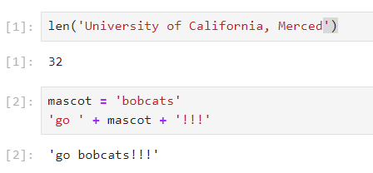
Strings
"go bobcats!!"
'19'
'i am 28 years old'
""
''
The third key data type in Python is string. Strings are used to store text.
A string is a sequence of characters with single quotes '' or double quotes "".
Python strings
state = "California"
Since strings are values, they can also be used in assignment statements.
A few string operations:
len(): string length, i.e., the number of characters in a string
+ : string concatenation

Slide 39
Conversion and Casting
1. Assigning Names
2. Call Expressions
3. The str Data Type
4. Conversion and Casting
➤

Slide 40
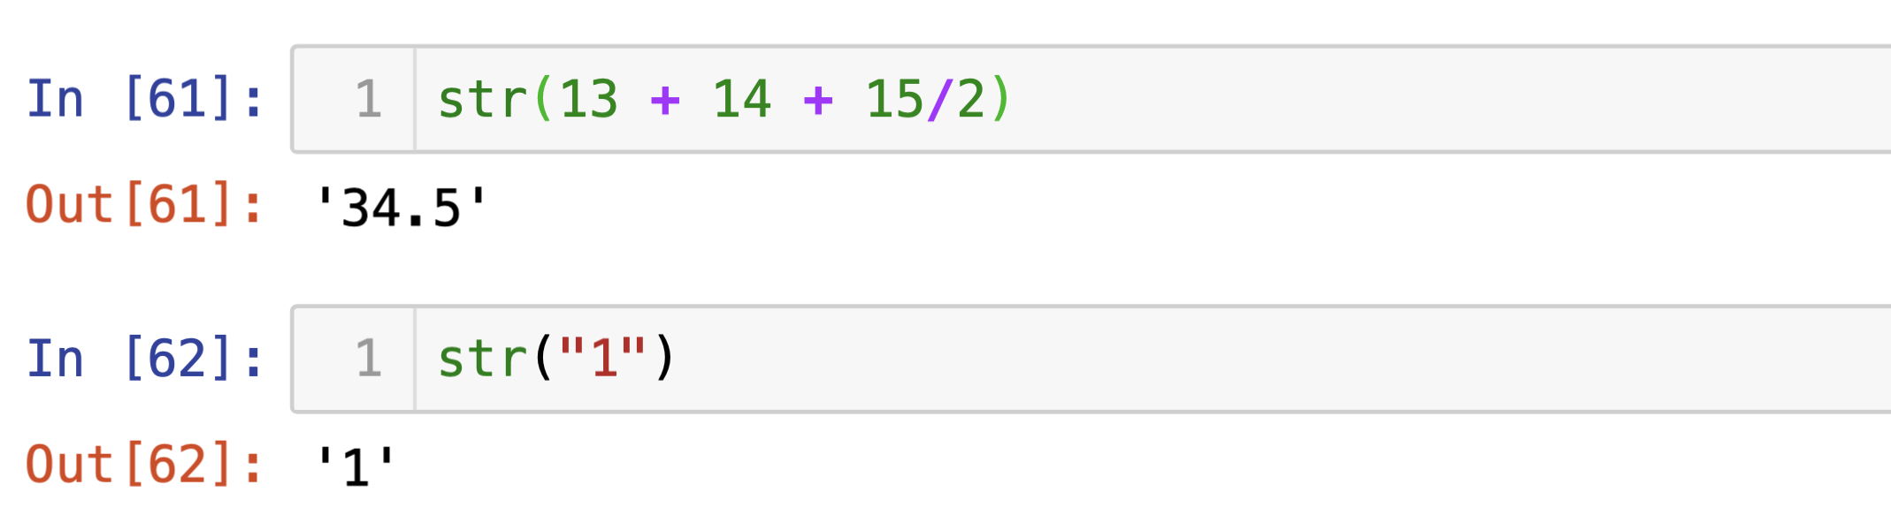
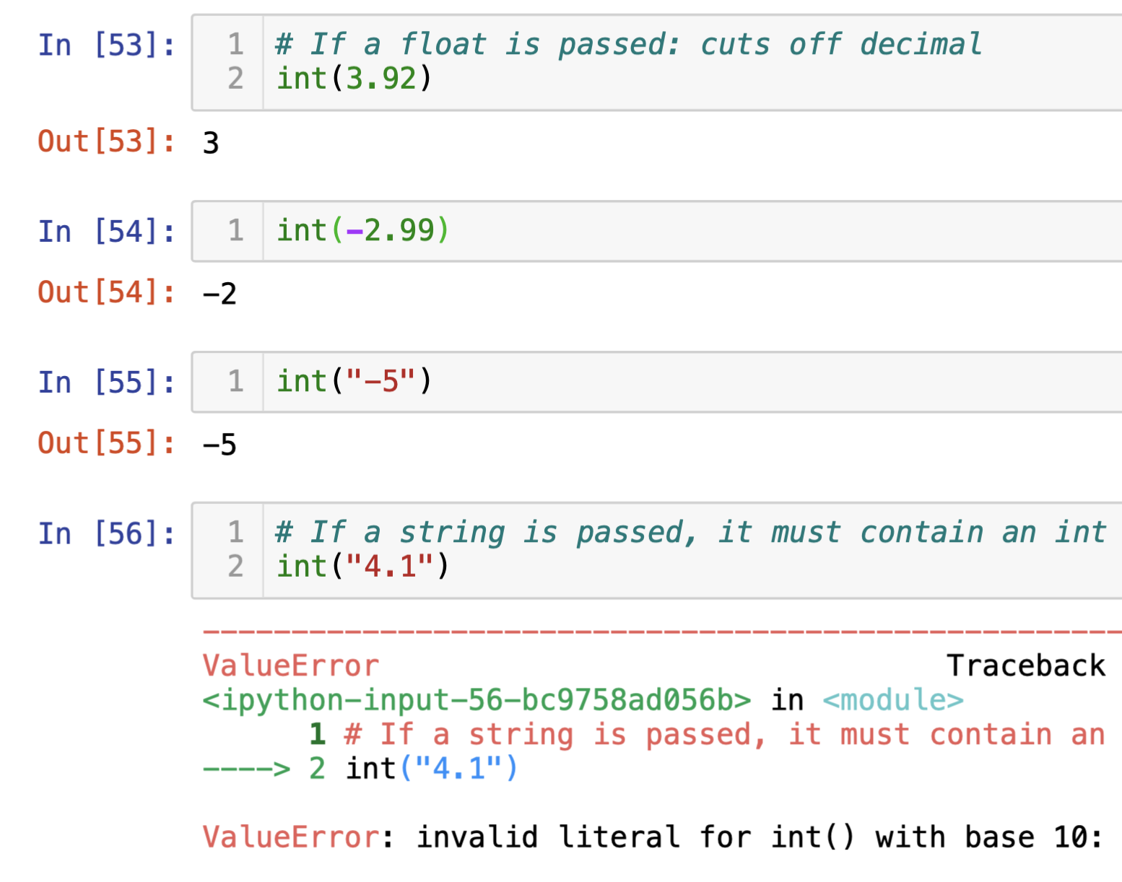
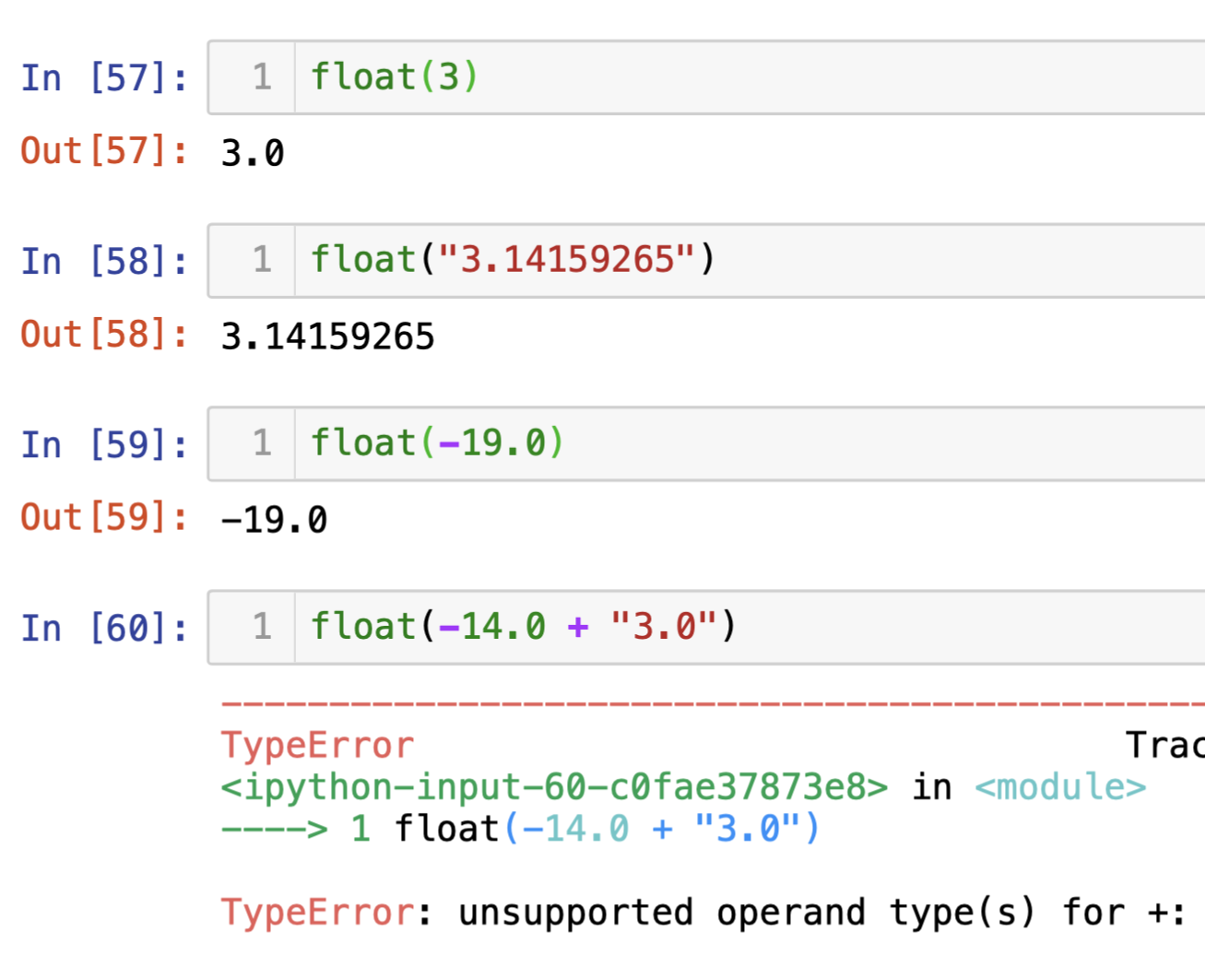
Typecasting
We can also typecast, or convert values between data types. Note that data type conversion is only valid “when it makes sense.”
int(x) # Returns x as an integer
float(x) # Returns x as a float
str(x) # Returns x as a string

Slide 41
Be careful...
Different types behave differently when used with the same functions and operators.
int, float
str
3 + 4 # 7
3 + 4.0 # 7.0
"3" + "4" # "34"
"3" + 4 # TypeError!
3 * 4 # 12
3 * 5.1 # 15.3
3 * 4.0 # 12.0
"3" * 4 # "3333"
"3" * 5.1 # TypeError!
"3" * 4.0 # TypeError!
max(3, 4) # 4
max("three", "four") # "three"

Slide 42
In Conclusion…

Slide 43
Summary
Functions in Python work the same way as functions in math for the most part: we pass in inputs, and they return outputs.
We can nest many function calls together.
Some functions, like print, don’t return anything.
We assign names to values so that we can use them later in our code.
We assign and update names by using assignment statements.
There are several rules and behaviors regarding names and assignment statements that you should be aware of.
Every value in Python has a data type. The behavior of some functions and operators change depending on the data types of the arguments.
Types so far: int, float, str.
We can convert between datatypes using int(), float(), str()

Slide 44
Recap
Next Time
Call Expressions
Assigning values
Strings
Conversion and Casting
Using print()
NoneType
Importing packages, Numpy
Arrays

